Slide 1
The Global Aviation Maintenance Industry: Overview and Issues Update Embassy Aviation Attaches Assembly Washington, D.C. January 23, 2019
Christian A. Klein Executive Vice President | Brett Levanto Vice President of Operations

Slide 2
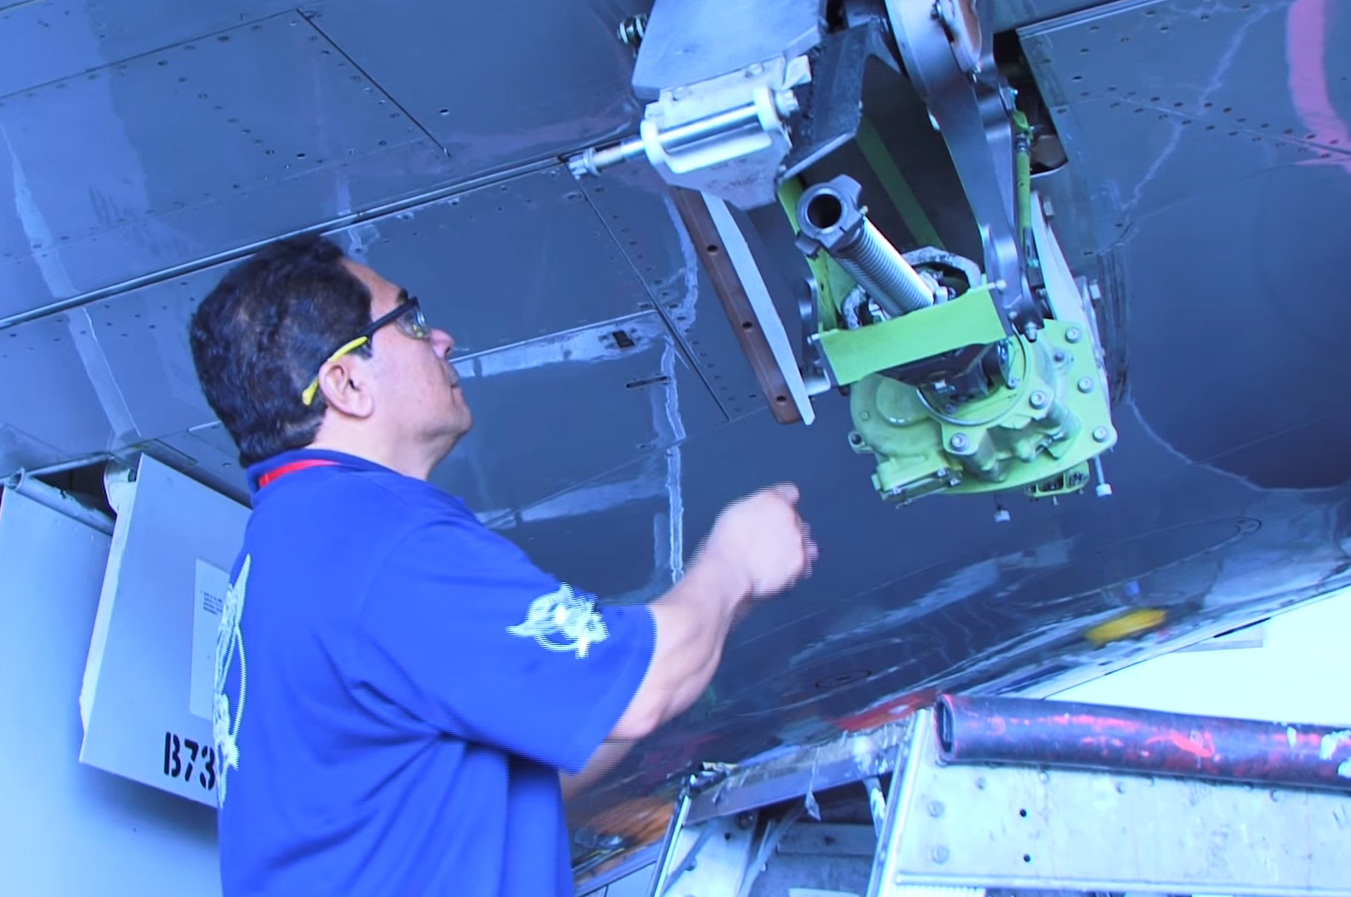
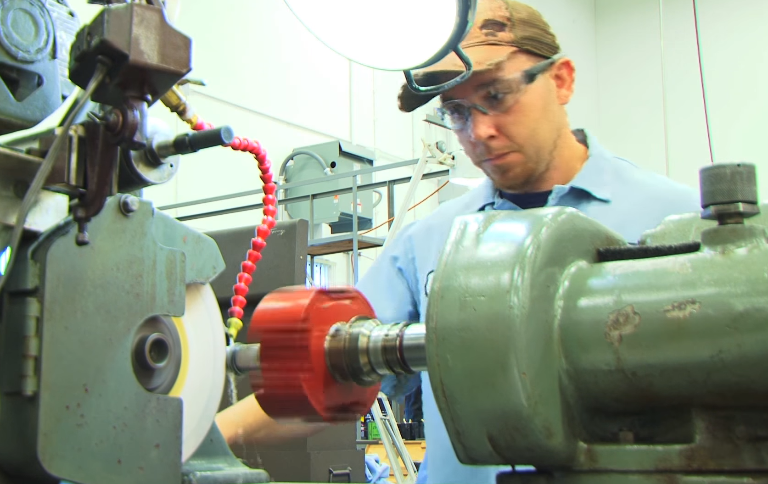
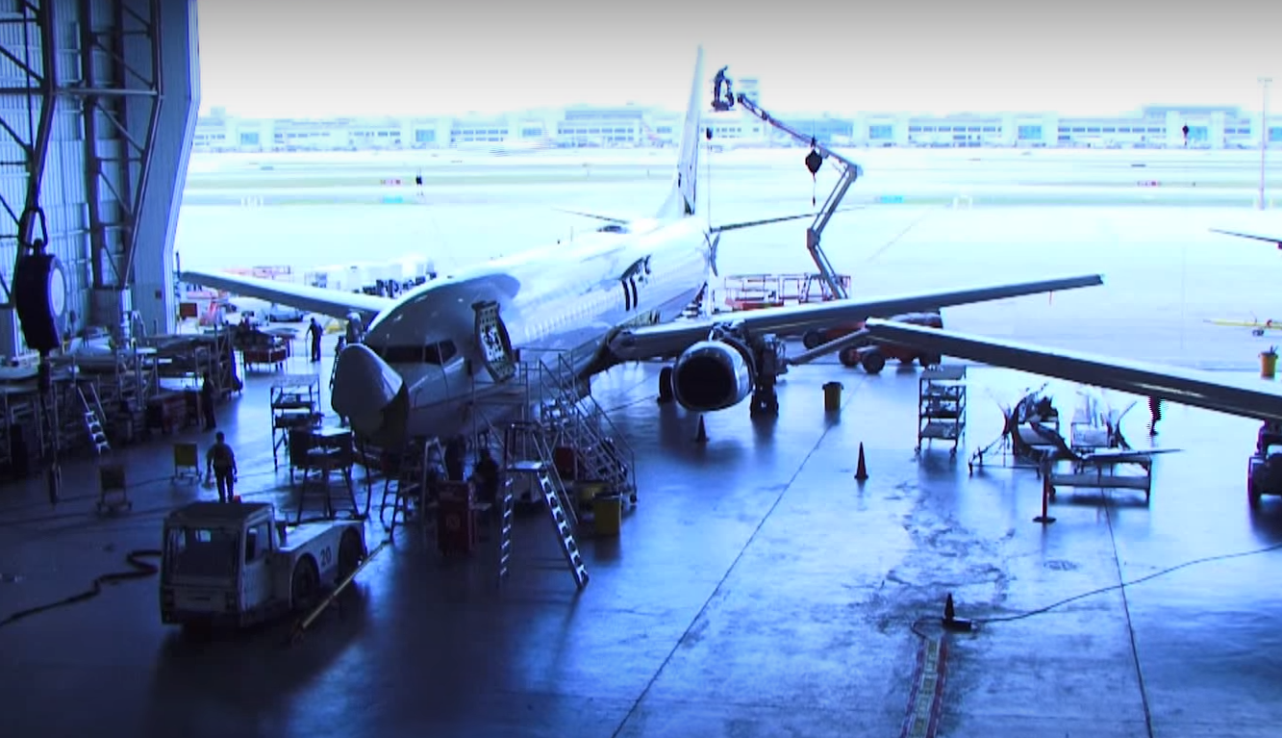
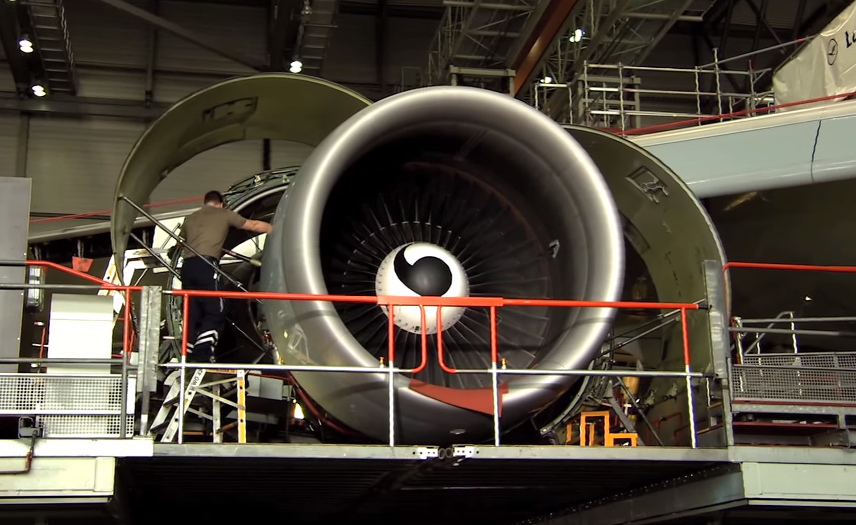
Overview
ARSA and Industry Overview
State of the Industry
Hot Issues
Moving the Ball Forward

Slide 3
ARSA Background: About the Association
The trade association for the global aviation maintenance industry
Based in Alexandria, Virginia
Regular members are companies that hold FAA part 145 certificates or equivalent certification from a civil aviation authority
Membership also includes airlines, manufacturers, other companies with interest in maintenance, schools, individuals
More than 400 members representing 520+ certificates
Managed by law firm of Obadal, Filler, MacLeod & Klein, PLC

Slide 4
ARSA Background: Members Include …
AAR Corp.
BBA Aviation
Chromalloy
Delta Tech Ops
Gulfstream Aerospace
HAECO Americas
HEICO Aerospace
Lufthansa Technik
Moog Aircraft Group
MRO Holdings
Southwest Airlines
The Boeing Corporation
The NORDAM Group
United Technologies
Wencor Group

Slide 5
ARSA Background: Members in …
Australia
Belgium
Brazil
Bulgaria
Canada
China
Costa Rica
Dubai
El Salvador
France
Germany
Hungary
Ireland
Israel
Italy
Japan
Malaysia
Malta
Mexico
Netherlands
Peru
Philippines
Poland
Singapore
Spain
Switzerland
Thailand
United Kingdom
United States

Slide 6
ARSA Background: What Do We Do?
Regulatory advocacy, compliance assistance, and training
Legislative advocacy/lobbying
Public relations for aviation maintenance industry
Workforce development (policy, promoting industry careers, supporting recruitment, training)
Services to reduce member costs of doing business

Slide 7
ARSA Background: MRO Industry Profile
Aircraft state of registry controls maintenance
Approved maintenance organizations (i.e., repair stations) often maintain multiple certificates to allow them serve international customer base (e.g., 1,400 U.S. repair stations are EASA approved and there are 895 FAA-certificated repair stations outside the United States)
Maintenance industry economic footprint:
 | Global | USA
Direct annual economic impact | $77 billion | $47 billion
Employment | 380,156 | 279,000
Number of firms | 4,878 | 4,025

Slide 8
State of the Industry
These are “heydays” for commercial aviation industry: U.S. air carriers had three years of record or near record profit for the first time in history thanks to lower fuel prices and operational efficiencies
Rising demand for air travel leading to increased demand for aircraft, which is keeping production lines busy; low fuel prices mean airlines are hanging on longer to older jets, which is increasing demand for MRO services
Demand for air travel growing faster than GDP in developed and developing world due to rising disposable income in emerging markets, expanding numbers of well-off retirees, increase in digital connectivity worldwide and spike in the number and size of low-cost carriers and ultra-low-cost carriers (which has created downward pressure on airfares and other travel costs)
Source: Oliver Wyman 2018 Global Fleet & MRO Market Assessment (prepared for ARSA)
Notes:
Look for shift in relative distribution of passenger traffic from North America to China. ME airlines will gain long-haul share.
This past year, non-Boeing/Airbus aircraft made up only 17% of all deliveries, a significant decline from a high of 29% in 2009. Smaller aircraft manufacturers are likely to see even stronger headwinds as they lack the scale and offerings to meet the desire for larger aircraft.

Slide 9
State of the Industry cont’d
Global fleet expected to grow 3.7 percent annually over the next decade
Narrow-body aircraft will be 2/3 of global fleet by 2028 due operating costs, range, and capabilities that allow them to encroach on territory once reserved for wide-bodies
OEMs pushing into the MRO space (Boeing has goal to provide $50 billion in MRO services)
Risks: Fast growth can lead to strained capacity, which can lead to higher prices, upward wage pressure and labor shortages
By 2027, nine percent gap between number of technicians and demand
Source: Oliver Wyman 2018 Global Fleet & MRO Market Assessment (prepared for ARSA)
Notes:
Look for shift in relative distribution of passenger traffic from North America to China. ME airlines will gain long-haul share.
This past year, non-Boeing/Airbus aircraft made up only 17% of all deliveries, a significant decline from a high of 29% in 2009. Smaller aircraft manufacturers are likely to see even stronger headwinds as they lack the scale and offerings to meet the desire for larger aircraft.

Slide 10
Risks and Opportunities: 2018 ARSA Survey
50% of ARSA members report unit margin/profitability has increased in past two years (vs. 14% reporting decrease – last year was 46% versus 33%)
67% expect revenue and markets to grow (vs. only 2% expecting contraction – last year was 59% versus 8%)
68% expect to add workers (vs. two percent planning layoffs – last year was 55% versus one percent)
But 82% report difficulty finding qualified technical workers over past two years (same as last year)
Impact of technical worker shortage: 80% report it has taken longer to complete work for customers, 28% have not added new capabilities, 20% have turned down work, 11% have decided against facility expansion
ARSA projects members had 2,500 unfilled technical positions as of mid 2018 and will forego between $333.5 million and $642.5 million in revenue if those vacant positions remain unfilled

Slide 11
Risks and Opportunities: 2018 ARSA Survey
Biggest threats identified by members:
Difficulty finding and retaining technical talent (tie)
1. Availability of maintenance information (aka, repair manuals or instructions for continued airworthiness)
3. Regulatory costs/burdens
4. Inconsistencies between national regulatory systems
5. Restrictions on international trade and markets

Slide 12
Hot Issues: International Regulatory Coordination
ARSA economic data proves bilateral aviation safety agreements (with maintenance annex guidance) reduce compliance costs significantly (with disproportionate benefit on small companies)
ARSA engages with regulators on global basis through Maintenance Management Team (FAA, EASA, TCCA, ANAC Brazil), EASA Engineering & Maintenance Technical Committee, FAA Aviation Rulemaking Advisory Committee, etc.
BHAG is getting MMT authorities to fully mutually recognize each other’s maintenance organizations
Promoting bilaterals and reduced barriers on Capitol Hill

Slide 13
Hot Issues: U.S. Government Shutdown
70 percent of respondents to ARSA survey report being negatively affected
Most common impact/concern is renewal of repair station approvals (U.S. facilities with EASA authorization and foreign FAA part 145 certificate holders)
ARSA has engaged with FAA and EASA to encourage temporary work-around (release pending)
Impacting members ability to serve international customers
ARSA urging members to consider seeking new delegation authority from FAA to prevent future disruptions

Slide 14
Hot Issues: Effects of Tariffs
General consternation about hostility to free trade within administration and Congress b/c an international industry
Most members say it’s too soon to tell what impact will be
Biggest concerns: impact of aluminum prices (e.g., for propeller blades and hubs)
Under WTO Agreement on Trade in Civil Aircraft parts are imported into United States (including for repair) duty-free
ARSA concerned about potential non-tariff barriers (e.g., new restrictions on foreign FAA part 145 facilities and potential retaliation against U.S. industry)

Slide 15
Hot Issues: Brexit
UK’s status within EASA still uncertain pending UK-EU negotiations (UK wants to remain part of EASA)
If no deal, UK will recognize EASA certificates, approvals and licenses for at least two years following Brexit (including EASA approvals to U.S. repair stations)
EASA accepting early third country approval applications from UK persons
EU proposing to temporarily extend validity/recognition of certain of EASA certificates for UK persons
EASA says it will recognize validity of EASA- approved components on aircraft, but not for components not already installed (could lead to “stranded” inventory)
Some ARSA members have changed (or plan to change) state of design from UK to other EU country
UK CAA is coordinating with United States, Canada and Brazil to ensure replacement BASAs are in place post-Brexit (1995 UK-US bilateral is still in force and can “accommodate all of the technical annexes currently implemented under the EU-US BASA”, but implementation procedures are out of date)
How has U.S. government shutdown impacted negotiations?
ARSA is waiting, watching and providing resources to members as they become available

Slide 16
Hot Issues: 2018 FAA Reauthorization Law
ARSA achievements:
Preventing new mandates/restrictions on repair stations (foreign and domestic)
Ensuring maintenance industry representation on key stakeholder bodies
Addressing technician shortage through:
New $5 million grant program to recruit and train technical workers
GAO reports on industry workforce
Enhancing value of part 65 repairman certifications
ARSA is tracking implementation of 44 FAA law provisions that will potentially impact maintenance industry, including:
Sec. 241: Directs DOT to promote U.S. safety standards, defends U.S. approvals, use bilaterals to reduce redundancy and unnecessary costs
Sec. 242: FAA may accept foreign airworthiness directives and alternative methods of compliance related to safe operation of aircraft from bilateral countries that are state of design
Sec. 243: Directs FAA to promote U.S. safety standards abroad and work with foreign governments to facilitate acceptance of FAA approvals and standards, report to Congress on international engagement
Sec. 1956: Directs TSA to review security-related standards across global aviation system

Slide 17
Hot Issues: Risks in New Political Environment
Proposals in prior Congress to “shame” carriers for using contract maintenance, require supervisors at foreign repair stations to have FAA A&P certificate, restrict new foreign repair station certificates
Senate’s leading opponent of contract maintenance (Sen. Claire McCaskill D-Mo.) lost reelection bid
New House T&I leadership is hostile to contract maintenance (esp. foreign repair stations)
New members of Congress unfamiliar with industry and regulatory regime
Expect more oversight scrutiny of FAA oversight of foreign certificate holders
FAA has not yet issue final rule on drug and alcohol testing for foreign repair stations

Slide 18
Moving the Ball Forward
Use ARSA resources and expertise
Set up automatic searches on Congress.gov for terms like “repair station” and “bilateral aviation safety agreement”
Engage with ARSA members from your countries to understand how they are impacted by U.S. legislation and regulation (e.g., during ARSA Conference (March 12 to 15))
Promote regulatory cooperation
Serve as resource about your country’s laws
Help ARSA identify new allies in your home country

Slide 19
Keep in Touch…
Christian A. Klein
Executive Vice President
Tel. 703.739.9543 x 106
Email christian.klein@arsa.org
Twitter @caaklein
Brett Levanto
Vice President of Operations
Tel. 703.739.9543
Email brett.levanto@arsa.org
Twitter @levantoair

Slide 20
DISCUSSION

